Slide 1
OFDM
Dr. M. Shamim Kaiser

Slide 2
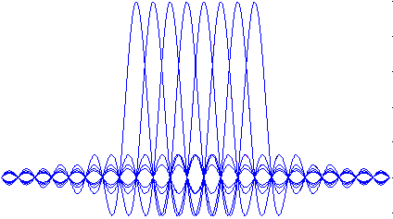
OFDM Transmitter and Receiver
x bits
Serial Data Input
Serial-to- Parallel
Converter
Signal
Mapper
IFFT
Parallel-
to-Serial
Converter
Guard
Interval
Insertion
D/A &
Low pass
Filter
Up-
Converter
Fast Fourier Transform
Subchannels
Guard Intervals
Channel
Symbols
Frequency
Time
x bits
Serial Data Output
Parallel-
to-Serial
Converter
Signal
Demapper
One-tap
Equalizer
FFT
Serial-to- Parallel
Converter
Guard
Interval
Removal
A/D
Down-
Converter

Slide 3
OFDM Transmitter
x1=[0,0]
d1=1
x2=[0,1]
d2=i
x=[0,0,0,1,1,0,1,1,….]
x3=[1,0]
d3=-1
x4=[1,1]
d4=-i
…..

Slide 4
OFDM Output Waveform
CP
CP
CP
CP
DATA
CP

Slide 5
Series and Parallel Concepts
1/3
In OFDM system design, the series and parallel converter is considered to realize the concept of parallel data transmission.

Slide 6
Series and Parallel Concepts
2/3
Series
In a conventional serial data system, the symbols are transmitted sequentially, with the frequency spectrum of each data symbol allowed to occupy the entire available bandwidth.
When the data rate is sufficient high, several adjacent symbols may be completely distorted over frequency selective fading or multipath delay spread channel.

Slide 7
Series and Parallel Concepts
3/3
Parallel
The spectrum of an individual data element normally occupies only a small part of available bandwidth.
Because of dividing an entire channel bandwidth into many narrow subbands, the frequency response over each individual subchannel is relatively flat.
A parallel data transmission system offers possibilities for alleviating this problem encountered with serial systems.
Resistance to frequency selective fading

Slide 8
Modulation/Mapping
1/1
The process of mapping the information bits onto the signal constellation plays a fundamental role in determining the properties of the modulation.
An OFDM signal consists of a sum of sub-carriers, each of which contains M-ary phase shift keyed (PSK) or quadrature amplitude modulated (QAM) signals.
Modulation types over OFDM systems
Phase shift keying (PSK)
Quadrature amplitude modulation (QAM)

Slide 9
Mapping - Phase Shift Keying
1/2
M-ary phase shift keying
Consider M-ary phase-shift keying (M-PSK) for which the signal set is
where is the signal energy per symbol, is the symbol duration, and is the carrier frequency.
This phase of the carrier takes on one of the M
possible values, namely , where

Slide 10
Mapping - Phase Shift Keying
2/2
An example of signal-space diagram for 8-PSK .

Slide 11
Mapping – Quadrature Amplitude Modulation
1/2
The transmitted M-ary QAM signal for symbol i can be expressed as
where E is the energy of the signal with the lowest amplitude, and , and are amplitudes taking on the values, and,
where M is assumed to be a power of 4.
The parameter a can be related to the average signal energy ( ) by

Slide 12
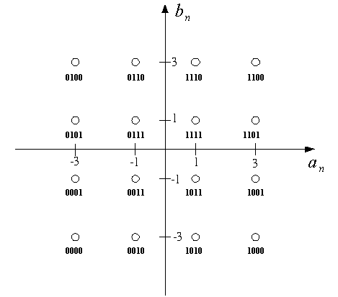
Mapping – Quadrature Amplitude Modulation
2/2
An example of signal-space diagram for 16-square QAM.

Slide 13
IFFT and FFT
1/1
Inverse DFT and DFT are critical in the implementation of an OFDM system.
IFFT and FFT algorithms are the fast implementation for the IDFT and DFT.
In the IEEE 802.11a, the size of IFFT and FFT is N=64.

Slide 14
Signal Representation of OFDM using IDFT/DFT
1/2
Signal representation of OFDM using IDFT/DFT
Now, consider a data sequence , and ,
where , , and is an
arbitrarily chosen symbol duration of the serial data
sequence .

Slide 15
Signal Representation of OFDM using IDFT/DFT
2/2
If these components are applied to a low-pass filter at time intervals

Slide 16
Orthogonality
2/2
Digital communication systems
In time domain In frequency domain
OFDM
Two conditions must be considered for the orthogonality between the subcarriers.
1. Each subcarrier has exactly an integer number of cycles in the FFT interval.
2. The number of cycles between adjacent subcarriers differs by exactly one.

Slide 17
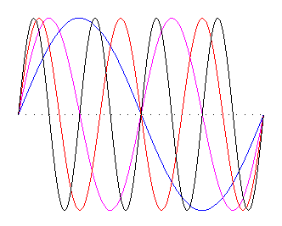
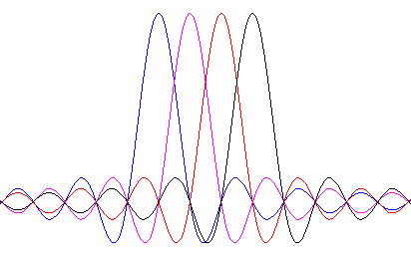
Orthogonality
2/2
Time domain Frequency domain
Example of four subcarriers within one OFDM symbol
Spectra of individual subcarriers

Slide 18
Guard Interval and Cyclic Extension
1/7
OFDM symbol
OFDM symbol duration .

Slide 19
Guard Interval and Cyclic Extension
2/7
Two different sources of interference can be identified in the OFDM system.
Intersymbol interference (ISI) is defined as the crosstalk between signals within the same sub-channel of consecutive FFT frames, which are separated in time by the signaling interval T.
Inter-carrier interference (ICI) is the crosstalk between adjacent subchannels or frequency bands of the same FFT frame.

Slide 20
Guard Interval and Cyclic Extension
3/7
Delay spread
Environment | Delay Spread
Home | < 50 ns
Office | ~ 100 ns
Manufactures | 200 ~ 300 ns
Suburban | < 10 us

Slide 21
Guard Interval and Cyclic Extension
4/7
For the purpose to eliminate the effect of ISI, the guard interval could consist of no signals at all.
Guard interval (or cyclic extension) is used in OFDM systems to combat against multipath fading.
:guard interval
:multi path delay spread
In that case, however, the problem of intercarrier interference (ICI) would arise.
The reason is that there is no integer number of cycles difference between subcarriers within the FFT interval.

Slide 22
Guard Interval and Cyclic Extension
4/7

Slide 23
Guard Interval and Cyclic Extension
5/7
To eliminate ICI, the OFDM symbol is cyclically extended in the guard interval.
This ensures that delayed replicas of the OFDM symbol always have an integer number of cycles within the FFT interval, as long as the delay is smaller than the guard interval.

Slide 24
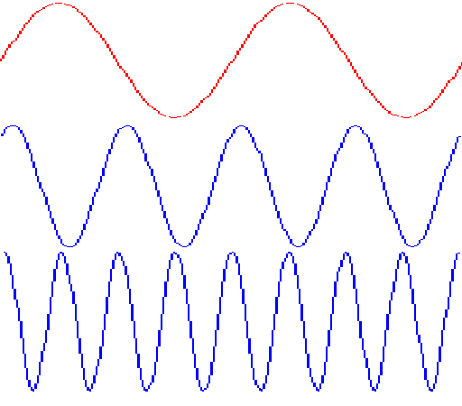
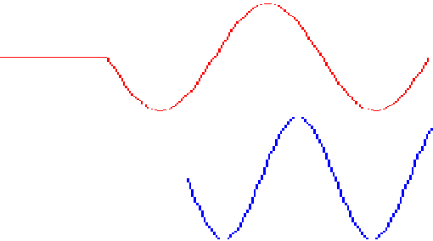
Guard Interval and Cyclic Extension
6/7
Effect of multipath with zero signals in the guard interval, the delayed subcarrier 2 causes ICI on subcarrier 1 and vice versa.
Part of subcarrier #2 causing ICI on subcarrier #1
Subcarrier #1
Delayed subcarrier #2
Guard time
FFT integration time=1/carrier spacing
Guard time
FFT integration time=1/carrier spacing
OFDM symbol time
OFDM symbol time

Slide 25
Guard Interval and Cyclic Extension
7/7
Time and frequency representation of OFDM with guard intervals.
1/T
Subchannels
Tg
Fast Fourier Transform
T
Guard Intervals
Frequency
Symbols
Time

